Slide 1
BUS TICKET MANAGEMENT

Slide 2
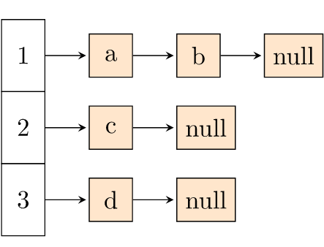
Implementation of Array of Linked lists in our project

Slide 3
Classes
Busnode
List
Bus
Choice

Slide 4
Concepts Implemented
Linked list application:
Node creation(Insert from end)
Node deletion(search by value)
Traversal
Inheritance
Encapsulation

Slide 5

Made by
Anshul Prasad (18070124011)
Drishti Singh (18070124026)
Gautam Bhandari (18070124027)
Ria Singh (18070124056)

